Slide 1
Software-Defined Storage
Lecturer: Ngo Huy Bien
Software Engineering Department
Faculty of Information Technology
University of Science
Ho Chi Minh City, Vietnam
nhbien@fit.hcmus.edu.vn

Slide 2

Objectives

Slide 3

Contents

Slide 4

References
Eno Thereska et al. (2013). IOFlow: A Software-Defined Storage Architecture.

Slide 5
IO Request [1]
The path of an IO request from a VM to a storage back-end is complex, traversing many layers.
A request also appears differently at each layer. For example, a file IO request like a read, write, create in a VM results in a block IO request in the hypervisor. This, in turn, results in Ethernet packets across the network, and finally another file IO request and block device request at the storage server.
Requests may traverse many other layers; for the Windows I/O stack there are over 18 stackable layer classes with functionality such as compression, replication, deduplication, virus checking.

Slide 6
End-to-end Policies (SLA)
Such complexity means that enforcing end-to-end (e2e) policies is hard.
It requires layers along the IO path to treat requests differently based on their contents.
Further, policies may need to be enforced at one or more or all layers along the path.
For example, prioritizing IOs from a VM to storage requires configuring all layers along the path.

Slide 7
Policies for IO Flows
The policies specify the treatment of IO flows from virtual machines to shared storage.
Flows are named using a four-tuple comprising human-friendly high-level identifiers: {VMs, operations, files, shares}.
For example, if a tenant with 100 VMs that perform data mining on files in “dataset A” is to be given high priority, the policy can be written as
{VM 1-100, *, *, “dataset A”} → High Priority.

Slide 8
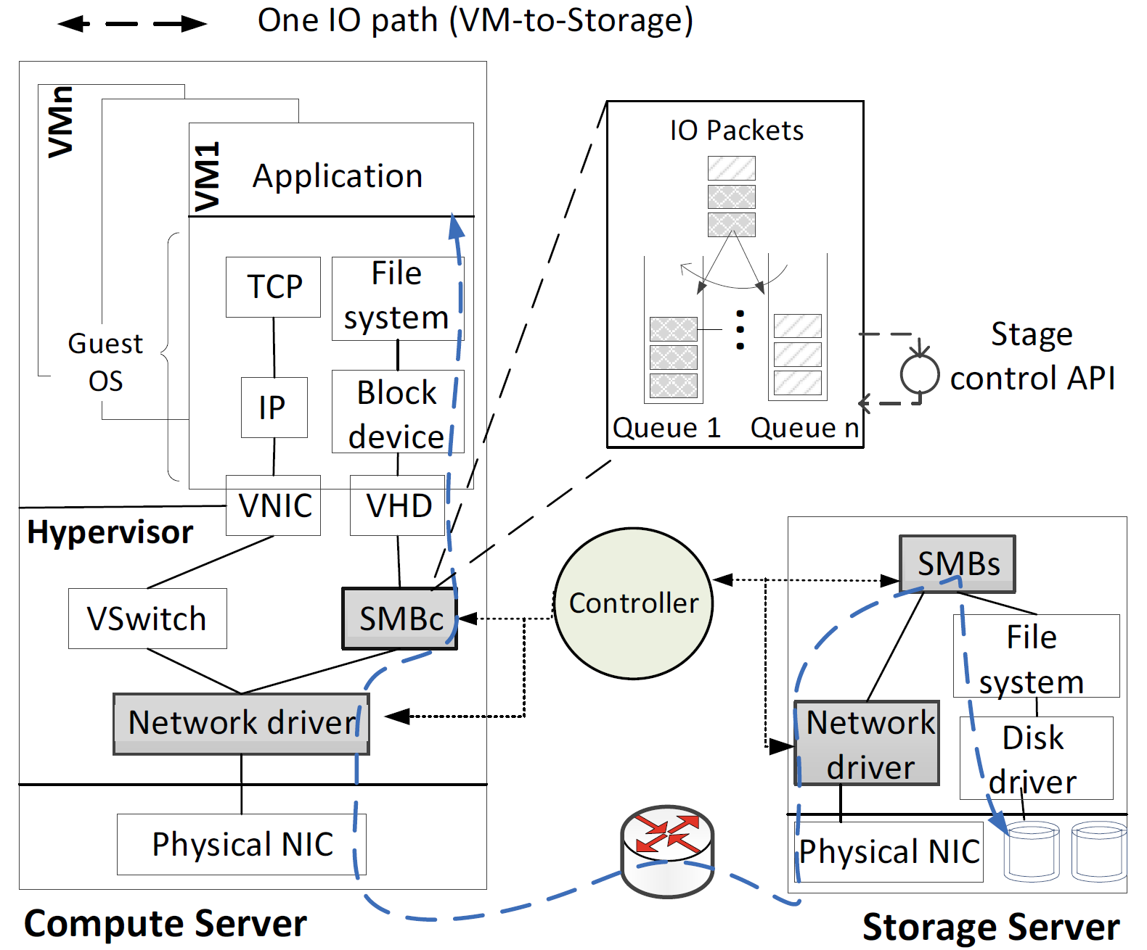
IOFlow
IOFlow is a software-defined storage architecture that enables IO flow policies in multi-tenant data centers.
IOFlow brings several IO stack stages (shaded) under unified control.
Each stage implements queues and queuing rules.
Figure 1

Slide 9
Stages
Figure 1 shows key layers along the IO stack in a typical data center. Any of these can serve as stages.
In our prototype, we have implemented the SMB client (SMBc at the hypervisor) and the SMB server (SMBs at the storage server) as stages for enforcing performance policies.
SMB is a distributed IO protocol that can run over RDMA.
We have also implemented the network drivers as IOFlow stages.

Slide 10
Controller
A logically centralized data center controller discovers and interacts with the stages in servers across the data center to maintain a topology graph.
It exposes this topology and information about individual stages to control applications built on top.
These control applications translate high-level flow policies into stage-specific configuration, namely queuing rules for assigning packets to queues and the queue properties.
Such translation may be done proactively when the tenant specifies a policy or reactively when a stage receives an IO request that does not match any existing queues and contacts the controller.

Slide 11
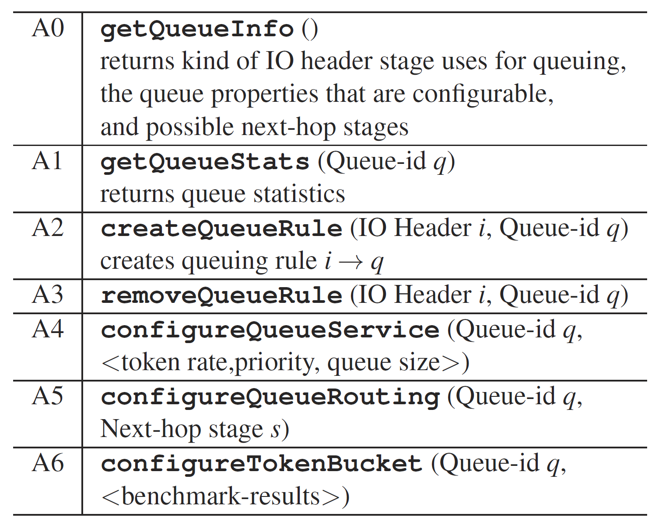
IOFlow's API for data-plane stages

Slide 12
Implementation
We implemented IOFlow on a Windows-based IO stack.
We implemented two kernel drivers that intercept storage IO traffic and each serves as an IOFlow stage: a storage driver that resides on top of the SMBc driver, and a storage driver below the SMBs driver.
We rely on the Windows storage IO and network IO stacks for supporting the injection of our storage and network drivers.
We have also added similar control to other optional stages along the IO path: a malware scanning device driver; a driver on top of the guest OS file system (NTFS) that allows for IO flow differentiation within a VM; network drivers in the hypervisor that allow for control of VM-to-VM traffic.

Slide 13

Thank You & See You Again

